Slide 1

Data Structure (and Algorithm)

Slide 2

Today Covered
After completing this lecture you will be able to know
What this course is about?
What is Data Type?
What is Abstract Data Type(ADT)?
What is Data Structure?
  What good will it do me to know about them?
  Why can't I just use arrays and for loops to handle my data?
Why do you need to study DS?
Classification of Data Structure
When does it make sense to apply what I learn here?
Conclusion

Slide 3
Lecture No 1
Introduction
(What, Why and Where Data Structure . . .)

Slide 4
WHAT

Slide 5
Introduction
What is primary job of a software engineer?
  To develop software
What is software?
  Programs that run on a device.
What is program?
  Data + logic

Slide 6
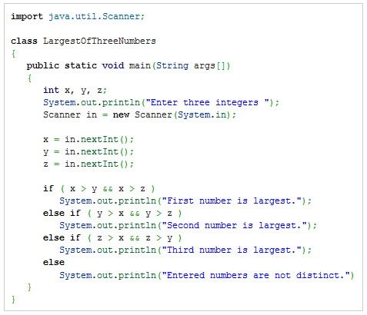
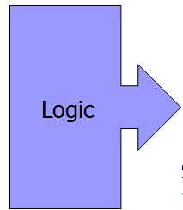
A simple Program with built in data type
What is Program?
  Program = Data + logic
java program finds largest of three numbers and then prints it.
Data

Slide 7
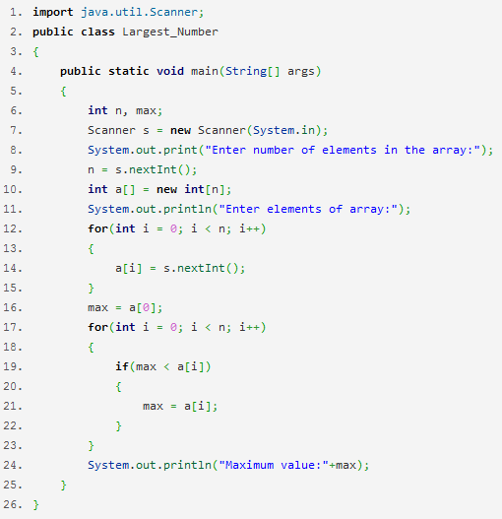
Operation on data set
What about if we have 100 elements and we want to find the largest element from them?
Data
Logic

Slide 8
Introduction
Computer:
  Machine that manipulates information/data.
Study of computer Science: includes the study of
  How information is organized in a computer?
  How it can be manipulated?
  How it can be utilized?
More powerful computers ⇒ more complex applications.
More complex applications demand more calculations.
Notes:
How information is organized in a computer?
This involves data structures (arrays, linked lists, trees, graphs, etc.), databases, file systems, and memory management.
How it can be manipulated?
This covers algorithms, programming languages, data processing, artificial intelligence, and software engineering principles.
How it can be utilized?
This includes applications of computing in fields like cybersecurity, networking, machine learning, cloud computing, and real-world problem-solving.

Slide 9




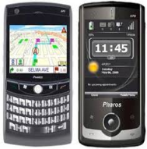


Introduction
If computer science is fundamentally the study of information/data, the first question that arises is, what is data/information?
Data is derived from a Latin word “Datum” which means collection.
So data can be defined as collection of facts and figures collected from any specific environment for a specific purpose.
SOURCE:.
Sensor technology and networks
(measuring all kinds of data)
Social Media
Mobile devices
(tracking all objects all the time)

Slide 10
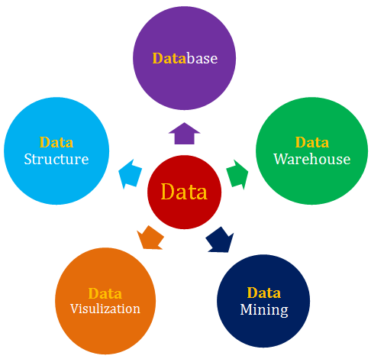
Subjects Related to DATA
Database can be used to store, retrieve and filter out data.
So Database can store data, but how do they store data internally?
This is where Data structure comes into play.
A data structure is the organization of data in a computer's memory or in a disk file.
collection of information that is store so that it can easily be accessed, managed, and updated.
a large store of data accumulated from a wide range of sources within a company and used to guide management decisions.
presentation of data in a pictorial or graphical format
Discovering hidden pattern in your data warehouse (large database).
"knowledge discovery in databases"

Slide 11
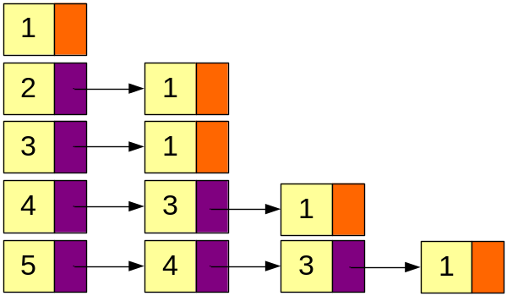
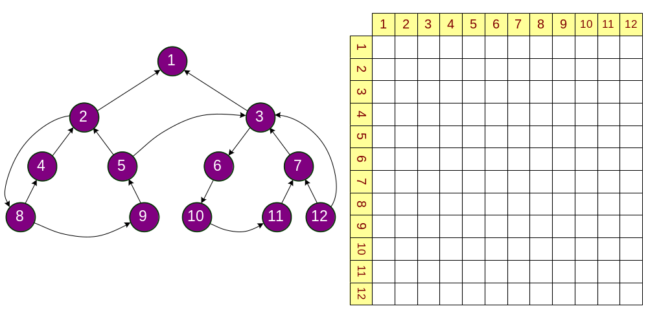
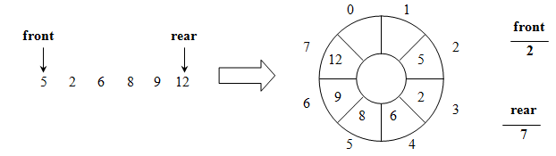
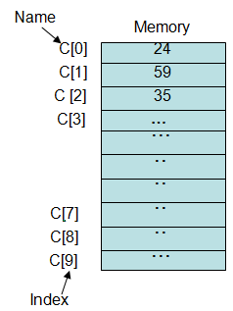
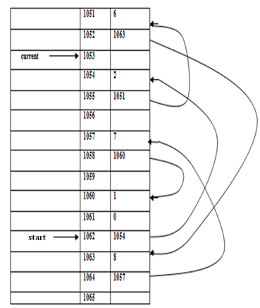
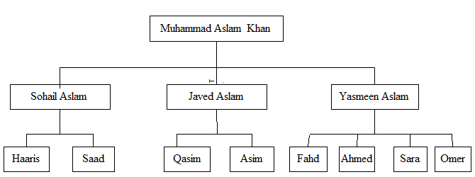
What about data Structure
Structure: how data is organized
  Place data contiguously
  Place data here and there with “links”
  Place data with “formula”(some specific order)

Slide 12
Algorithm and Data Structure
Choosing the right combination of algorithms and data structures is crucial for designing efficient software.
It's like selecting the best methods to process and organize information to achieve the desired outcomes.
Algorithms are like sets of instructions for solving specific problems
Data Structures are the way we organize and store information in a computer.

Slide 13
Example choosing the right combination of algorithms and data structures(1).
Imagine you're organizing a bookshelf, and you want to find a specific book.
Your books can be either arranged randomly (unsorted) or in alphabetical order (sorted).
Additionally, you have two methods to search for the book:
  looking at each book one by one (linear search) or
  using a more organized approach like dividing the shelf in half and narrowing down your search (binary search).
Randomly Arranged Books (Unsorted) with Linear Search:
If your books are randomly placed on the shelf, searching for a specific book involves looking at each book one by one until you find the right one.
This is similar to a linear search, where you start from one end and check each item until you find what you're looking for.

Slide 14
Example choosing the right combination of algorithms and data structures(2).
Alphabetically Arranged Books (Sorted) with Binary Search:
If your books are arranged alphabetically, you can use a more efficient method.
Let's say you're looking for a book that starts with the letter "M." You start by looking roughly in the middle of the shelf.
If the book you're looking for is before the middle point, you can eliminate the other half and focus on the first half. You keep narrowing down your search until you find the book.
This is analogous to a binary search, where you eliminate half of the remaining items with each comparison, making the search more efficient.

Slide 15
Consider the efficiency in different scenarios
If you only have a few books, the difference in efficiency between the two methods may not be significant, and you might opt for the simplicity of a linear search.
However, as your book collection grows, especially if it's well-organized (sorted), the advantage of using a more efficient method like binary search becomes evident. It allows you to find a book much faster, especially when dealing with a large number of items.

Slide 16
Conclusion
In this analogy,
Choosing the right combination involves considering the arrangement of your books (data structure) and the method you use to search for them (algorithm).
Depending on the size and organization of your bookshelf (dataset), you would pick the combination that provides the most efficient way to find a specific book.

Slide 17
Designing Data Structures
Each data structure has costs and benefits.
  Rarely is one data structure better than another in all situations.
A data structure requires:
  space for each data item it stores,
  time to perform each basic operation,
  programming effort.
Each problem has constraints on available time and space.
Only after a careful analysis of problem characteristics and solution requirements can we know the best data structure for the task.

Slide 18
Review of some basic Terminology/
concept

Slide 19
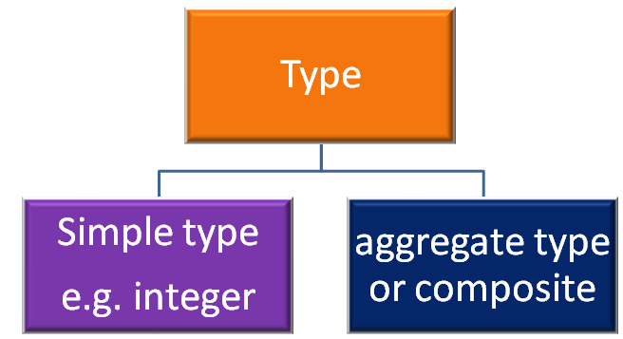
Data Type
Before going to study the actual subject, it will be a advantage if we aware ourselves about the various terms involved in the subject.
What is Type?
  A type is a collection of values.
  Example, the Boolean type consists of the values true and false.
  The integers also form a type.
  A bank account record
  will typically contain
  several pieces of
  information such as
  name, address,
  account number,
  And account balance.

Slide 20
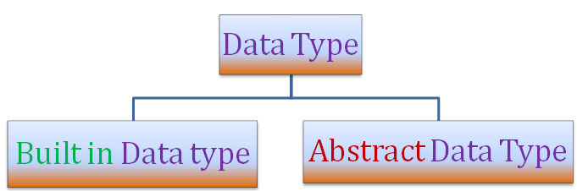
Data Type
What is Data item?
  a piece of information or a record whose value is drawn from a type. A data item is said to be a member of a type.
What is Data Type?
  A data type is a type together with a collection of operations to manipulate the type.
  DT = (T, O)
  For example, an integer variable is a member of the integer data type.
  Addition is an example of an operation on the integer data type.
Types of Data Type

Slide 21
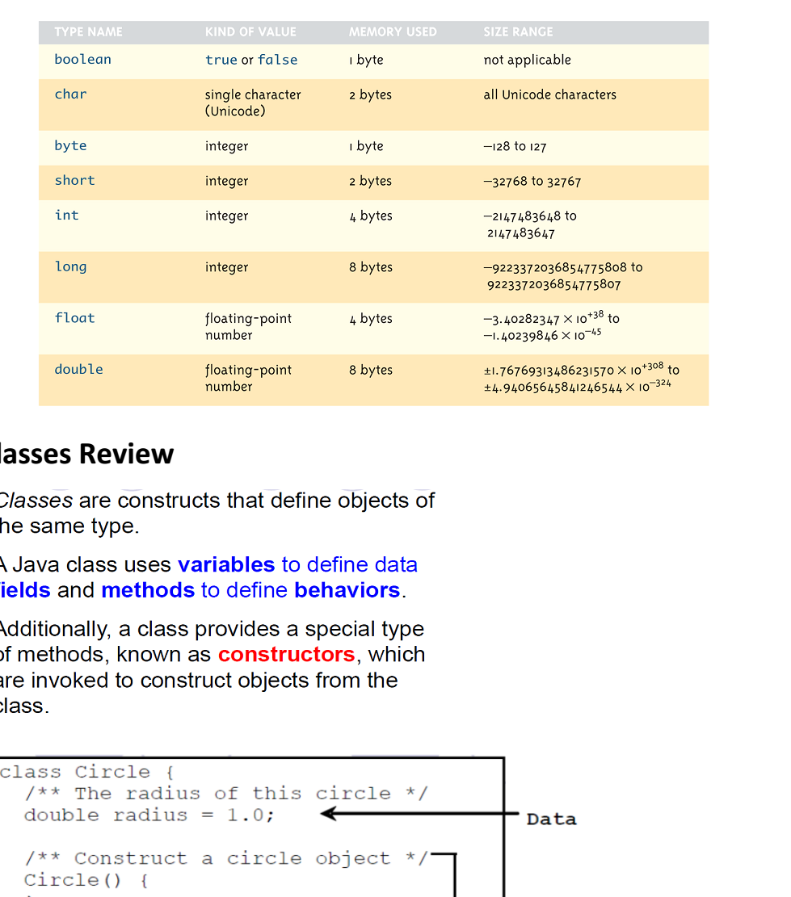
Built in Data Type
With every programming language, there is a set of data types called built in data types.
In Java, our programs are all built from just a few basic types of data:

Slide 22
A simple Program with built in data type
What is Program?
  Program = Data + logic
java program finds largest of three numbers and then prints it.
Data

Slide 23
Operation on data set
What about if we have 100 elements and we want to find the largest element from them?
Data
Logic

Slide 24
Need for Data Structures

Slide 25
Why not just ARRAY?
  Can I just use arrays and for loops to handle my data?
  No(Why)
  Example 1: How is undo and redo functionality typically implemented?
    Suppose you perform following in word application
    First you typed a word
    Secondly, you bold it
    Thirdly, You underlined it
    Fourth, you changed its color?
    Fifth you change its font size?
  In which order action will redo?

Slide 26
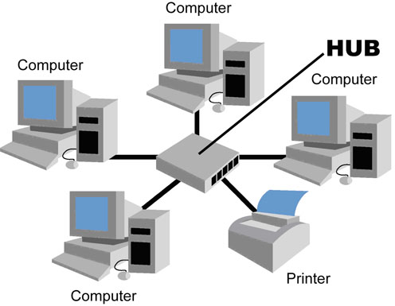
Why not just ARRAY?
  Example 2: Suppose there are four computers and one printer is connected. Computer B send print at time 9:30 am which takes 15 minutes for printing, Computer D send print command at time 9:35 which takes 7 minutes, computer A send print command at 9: 36 which takes 2 minutes and computer C send print command at 9:37 which takes 30 seconds. How printers organized these jobs in its buffer?
  In which order
  job will prints?

Slide 27
Need for Data Structures
When an application requires a special kind of data which is not available as built in data type then it is the programmer's burden to implement his own kind of data.
Here, the programmer has to give more effort regarding:
  How to store values for that data,
  What are the operations that meaningfully manipulate variables of that kind of data, amount of memory requires to store for a variable.
The programmer has to decide all these things and accordingly implement it.

Slide 28
Need for Data Structures
Programmer’s own data type is termed as abstract data type.
Abstract data type(ADT) is also alternatively termed as user-defined data type.
An ADT, in fact, can be built with the help of built in data type.
Some programming languages allow facility to build ADT easily.
For example, using struct/class in C/C++, and using record in Pascal, programmers can defined their own data type.

Slide 29
Relationship between data items, abstract data types (ADTs), and data structures
The relationship between data items, abstract data types (ADTs), and data structures is fundamental to understanding how information is organized and manipulated in computer science.

Slide 30
Data Items:
Data items refer to individual elements of data.
They can be simple, like a single value (e.g., an integer or a character), or complex, like a record or an object composed of multiple fields.
Examples of data items include numbers, strings, dates, and more complex structures like a person's information (name, age, address).

Slide 31
Abstract Data Types (ADTs):
An Abstract Data Type is a high-level description of a set of operations that can be performed on a collection of data items, along with the properties of those operations.
It defines what operations can be done on the data without specifying how they are implemented.
Examples of ADTs include lists, queues, stacks, sets, and dictionaries.

Slide 32
Data Structures:
Data structures are concrete implementations of abstract data types.
They represent the actual storage and organization of data in memory, and they determine how operations defined by the abstract data type are carried out.
For example, a list can be implemented using an array or a linked list as a data structure.
The choice of data structure impacts the efficiency of operations like insertion, deletion, and retrieval.

Slide 33
Example: Stack ADT and Its Data Structures:
Abstract Data Type (ADT): Stack
  Operations: Push, Pop, Peek, IsEmpty
Data Structures:
  Array-Based Stack:
    Uses an array to store elements.
    Push and Pop operations manipulate the array.
  Linked List-Based Stack:
    Uses a linked list to store elements.
    Push and Pop operations involve adjusting pointers in the linked list.

Slide 34
ADT and Data Structure
In this example, the Stack ADT defines a set of operations that can be performed on a collection of items, such as pushing an item onto the stack or popping an item off the stack.
The data structures, on the other hand, provide concrete implementations for the Stack ADT.

Slide 35
Classification

Slide 36
Classification of Data Structure
Data Structures are classified into two main groups:
  Linear Data structure
  Non Linear Data structure
Linear Data structure
  The data structures whose elements are arranged in a sequence are called linear data structure.
  There are two ways of representing linear data structures in memory.
    One way is to have the linear relationship between the elements by means of sequential memory locations.
    The other way is to have the relationship between the elements represented by means of pointers or links.
    Example: Arrays, Linked Lists, Stacks, Queues etc.

Slide 37
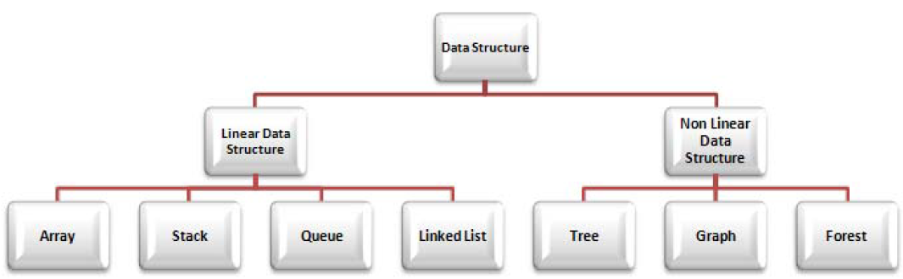
Classification of Data Structure
Non Linear Data structure
  The data structures whose elements are arranged in non-linear or non-sequence form are called non linear data structures
  Example: Trees, Graphs.
Up Shot

Slide 38
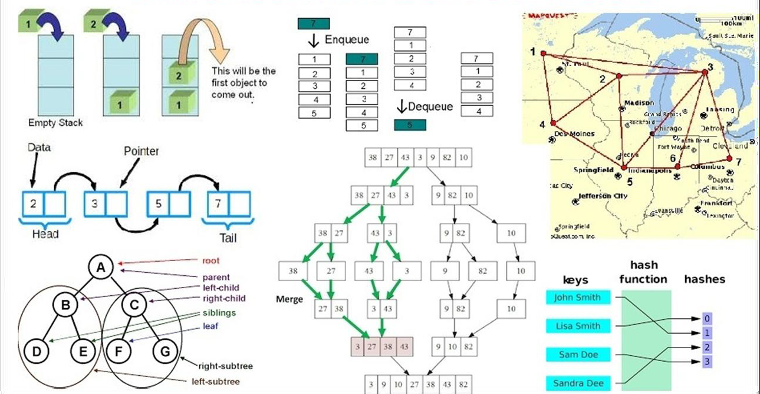
Summary
Upshot

Slide 39
Operations

Slide 40
Operations
The data in a data structure is processed using certain operations.
Some commonly used operations performed on data structures are:
  Insertion
  Deletion
  Traversing
  Search
  Sorting
  Merging

Slide 41
Operations
Insertion
  Adding new data items into a data structure is called inserting
Deletion
  Removing data items from a data structure is called deletion
Traversing
  Accessing each record or item in a data structure exactly once for processing is called traversing. It is also called visiting
Search
  Finding specific data items in a data structure is called searching
Sorting
  Arranging data items in a data structure into a specific order is called sorting
Merging
  Combing two list of data items into a single data list is called merging

Slide 42
CONCLUSION

Slide 43

Points to remember
Data Structure | A data structure is the organization of data in a computer's memory or in a disk file.
Classification | Linear Data structure, Non Linear Data structure
Program Efficiency | The correct choice of data structure allows major improvements in program efficiency.
Operations | Insertion, Deletion, Traversing, Searching, Sorting, Merging
Algorithm | An algorithm is a procedure for carrying out a particular task

